Slide 1
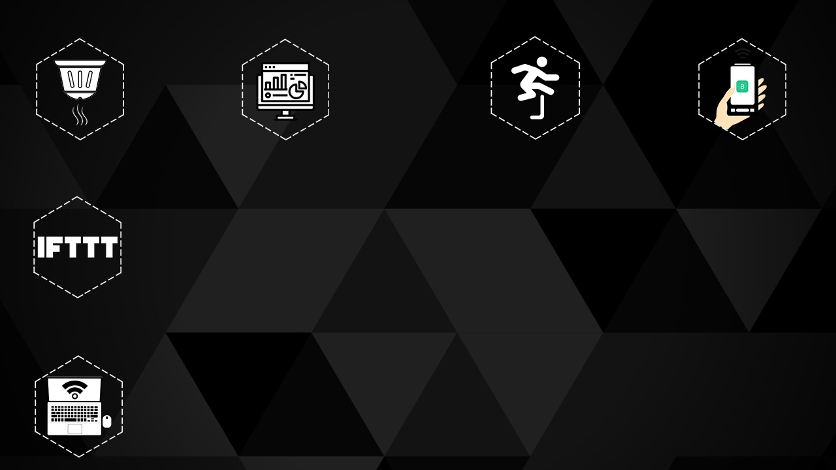
HEXBUGS 2.0
SESSION: Mobile Controlled Bot

Slide 2
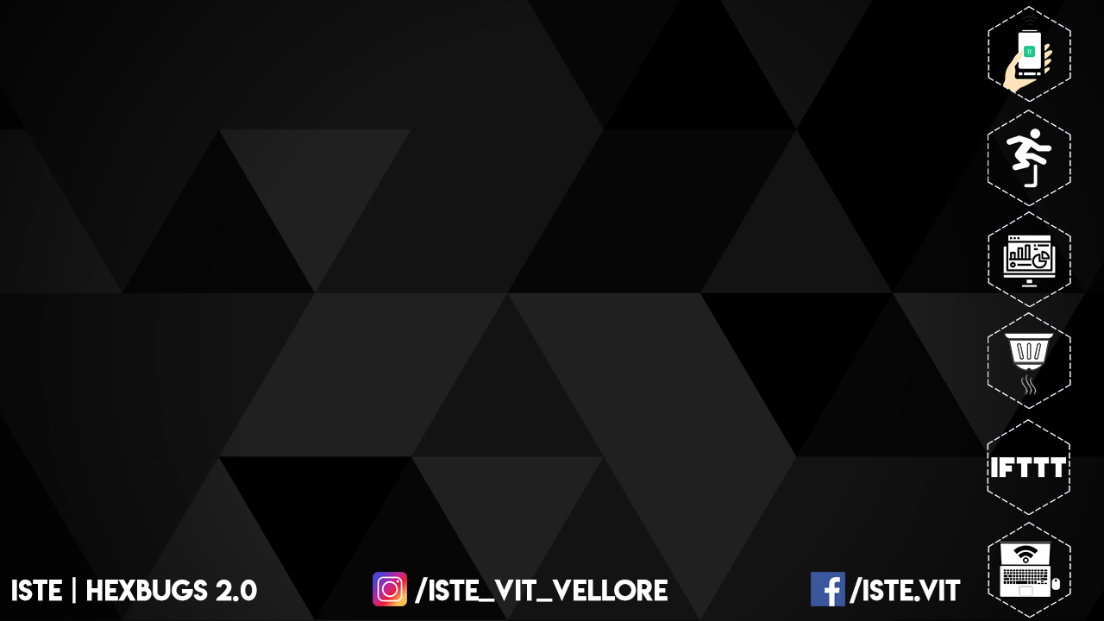
INTRODUCTION:. BLYNK
Blynk is a hardware-agnostic IoT platform with white-label mobile apps, private clouds, device management, data analytics, and machine learning.
It is a IoT platform to connect your devices to the cloud, design apps to control them, analyze telemetry data.

Slide 3
ADVANTAGES
Connect any device to open and secure cloud.
Connection management.
Flexible firmware API.
Fast and reliable.

Slide 4
INSTALLATION
Download Blynk app from Play store or App store.
Sign-up with any of your email-id.
Click on the new project so that it sends an API key to your respective emails.
By typing the Auth Token (the one which you get in your email) in the code you can connect your project with the blynk app and control from it.

Slide 5
Your microcontroller(ESP8266) , Laptop and mobile to be connected to a single server.

